Slide 1
Merge Sort
CSCI 3320, Fall 2020
B. Ricks, PhD

Slide 2
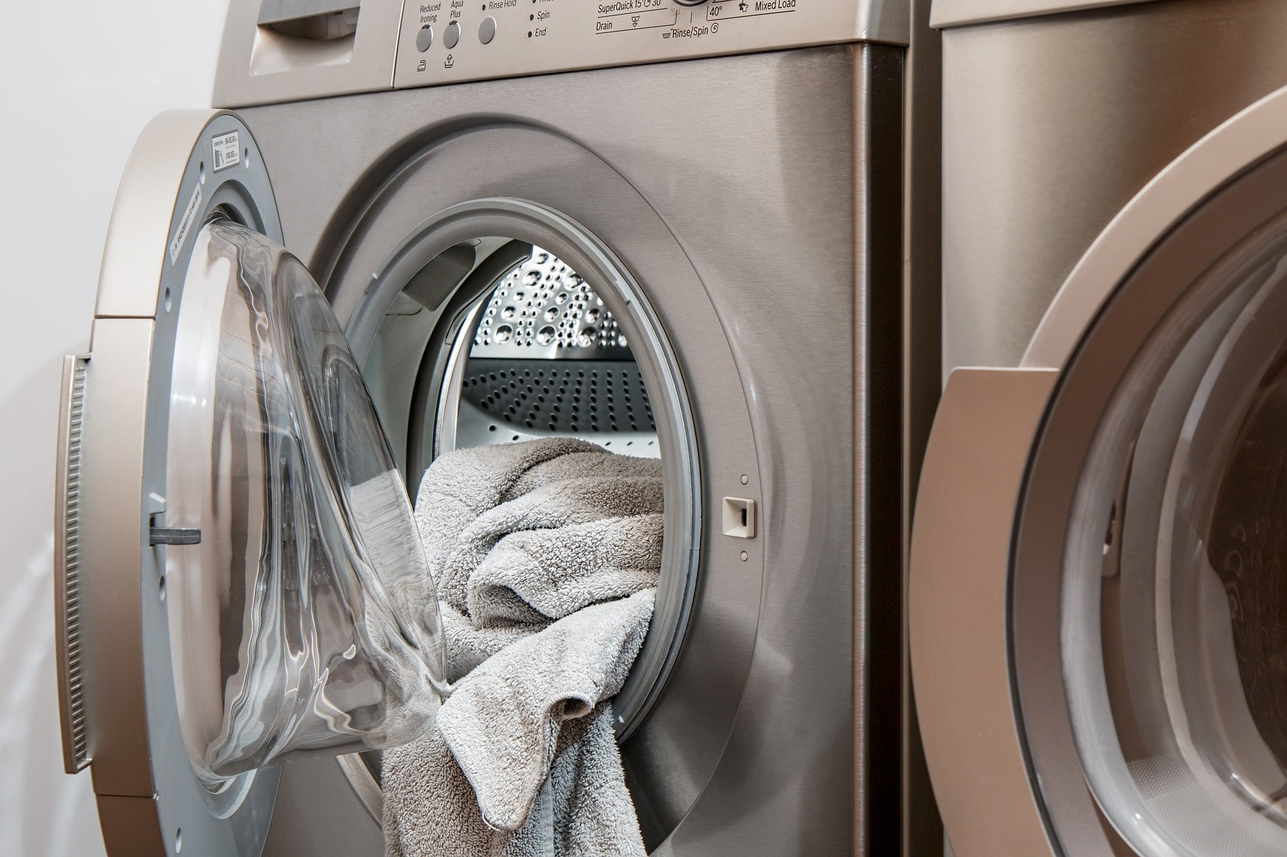
Sorting laundry as a couple

Slide 3
Working Backwards
What is the Big-O of combining two sorted lists of length $n$?
1 | 2 | 4 | 8
3 | 5 | 6 | 7

Slide 4
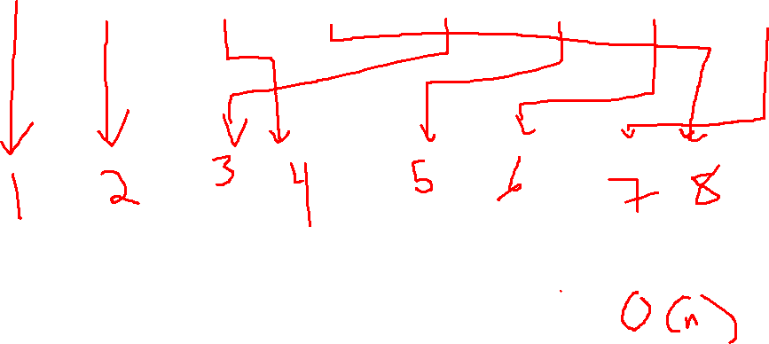
Big-O of combining sorted? 1/2
1 | 2 | 4 | 8
3 | 5 | 6 | 7

Slide 5
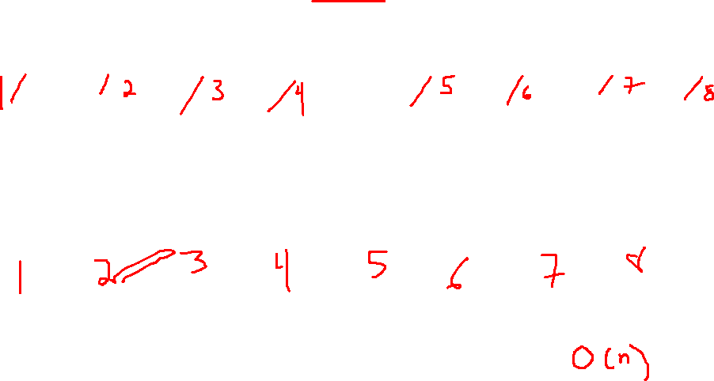
Big-O of combining sorted? 2/2
1 | 2 | 4 | 8
3 | 5 | 6 | 7

Slide 6
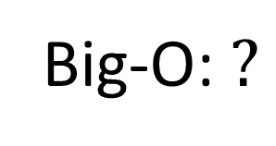
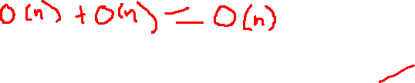
Working Backwards
What is the Big-O of combining two sorted lists of length $n$?
1 | 2 | 4 | 8
3 | 5 | 6 | 7
1 | 2 | 3 | 4 | 5 | 6 | 7 | 8
Big-O: $?$

Slide 7
How to get 2 sorted lists?
1 | 2 | 4 | 8
3 | 5 | 6 | 7

Slide 8

How to get 2 sorted lists? Start with 4
1 | 4
2 | 8
3 | 6
5 | 7
1 | 2 | 4 | 8
3 | 5 | 6 | 7

Slide 9

4 to 2 Big-O
1 | 4
2 | 8
3 | 6
5 | 7
1 | 2 | 4 | 8
3 | 5 | 6 | 7

Slide 10
How to get 4 sorted lists?
1 | 4
2 | 8
3 | 6
5 | 7

Slide 11
How to get 4 sorted lists? Start with 8.
1
4
2
8
3
6
5
7
1 | 4
2 | 8
3 | 6
5 | 7

Slide 12

8 to 4 Big-O.
1
4
2
8
3
6
5
7
1 | 4
2 | 8
3 | 6
5 | 7

Slide 13
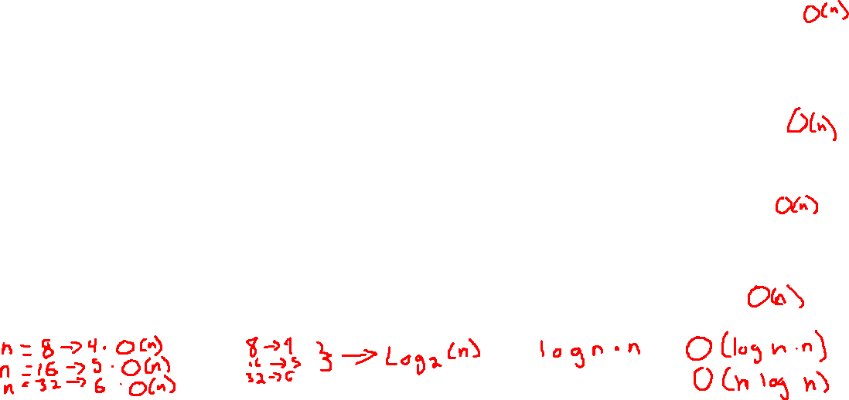
How many steps?
1
4
2
8
3
6
5
7
1 | 4
2 | 8
3 | 6
5 | 7
1 | 2 | 4 | 8
3 | 5 | 6 | 7
1 | 2 | 3 | 4 | 5 | 6 | 7 | 8

Slide 14
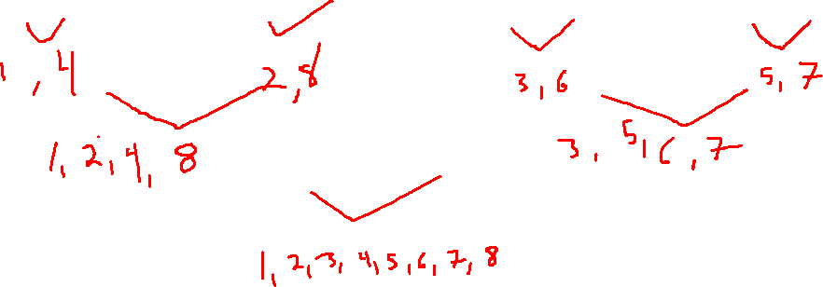
We worked backward to an unsorted list.
1
4
2
8
3
6
5
7

